Slide 1
MOSFET AMPLIFIER
• Metal Oxide Semiconductor Field Effect Transistor, or MOSFET is an excellent choice for small signal linear amplifiers as their input impedance is extremely high making them easy to bias.
• But for a mosfet to produce linear amplification, it has to operate in its saturation region, unlike the Bipolar Junction Transistor.
• But just like the BJT, it too needs to be biased around a centrally fixed Q-point.
• Enhancement MOSFETS, or eMOSFETS, can be classed as normallyoff (non-conducting) devices, that is they only conduct when a suitable gate-to-source positive voltage is applied, unlike Depletion type mosfets which are normally-on devices conducting when the gate voltage is zero.

Slide 2
DC BIASING THE MOSFET
• The universal voltage divider biasing circuit is a popular biasing
technique used to establish a desired DC operating condition of bipolar transistor amplifiers as well as mosfet amplifiers.
• The advantage of the voltage divider biasing network is that the MOSFET, or indeed a bipolar transistor, can be biased from a single
DC supply.
• A mosfet device has three different regions of operation.
Ohmic/Triode region
Saturation/Linear region
Pinch-off point.
• For a mosfet to operate as a linear amplifier, we need to establish a well-defined quiescent operating point, or Q-point, so it must be biased to operate in its saturation region

Slide 3
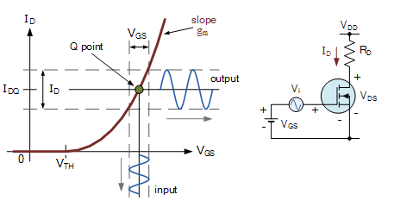
The Q-point for the mosfet is represented by the DC values, I_{D} and V_{GS} that position the operating point centrally on the mosfets output characteristics curve.
The common-source NMOS circuit above shows that the sinusoidal input voltage, V_{i} is in series with a DC source.
This DC gate voltage will be set by the bias circuit. Then the total gate-source voltage will be the sum of V_{GS} and V_{i}.

Slide 4
The DC characteristics and therefore Q-point (quiescent point) are all functions of gate voltage V_{GS}, supply voltage V_{DD} and load resistance R_{D}.
The MOS transistor is biased within the saturation region to establish the desired drain current which will define the transistors Q-point.

Slide 5
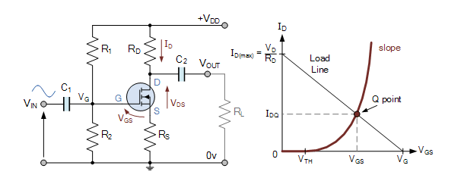
Basic Common Source MOSFET Amplifier

Slide 6
Basic Common Source MOSFET Amplifier
If we apply a small time-varying signal to the input, then under the right circumstances the mosfet circuit can act as a linear amplifier providing the transistors Q-point is somewhere near the center of the saturation region, and the input signal is small enough for the output to remain linear.

Slide 7
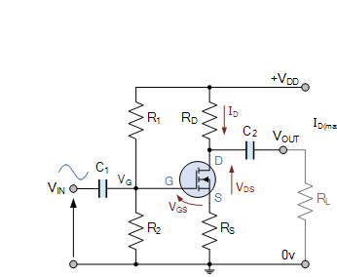
This simple enhancement-mode common source mosfet amplifier configuration uses a single supply at the drain and generates the required gate voltage, V_{G} using a resistor divider

Slide 8
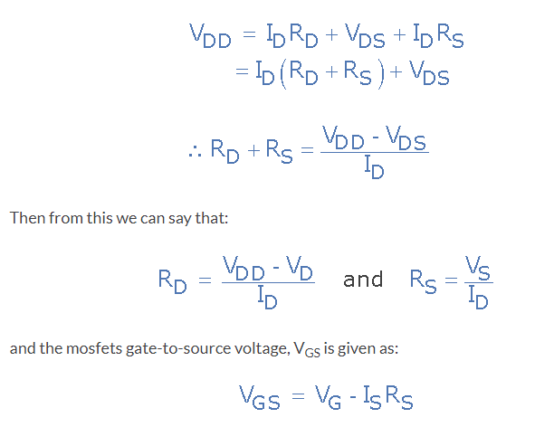

Slide 9
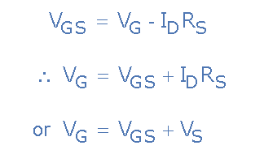
for proper operation of the mosfet, this gate-source voltage must be greater than the threshold voltage of the mosfet, that is V_{GS} > V_{TH}. Since I_{S} = I_{D}, the gate voltage, V_{G} is therefore equal too:
To set the mosfet amplifier gate voltage to this value we select the values of the resistors, R1 and R2 within the voltage divider network to the correct values.

Slide 10
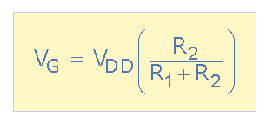
Note that this voltage divider equation only determines the ratio of the two bias resistors, R1 and R2 and not their actual values. Also it is desirable to make the values of these two resistors as large as possible to reduce their I²*R power loss and increase the mosfet amplifiers input resistance.

Slide 11
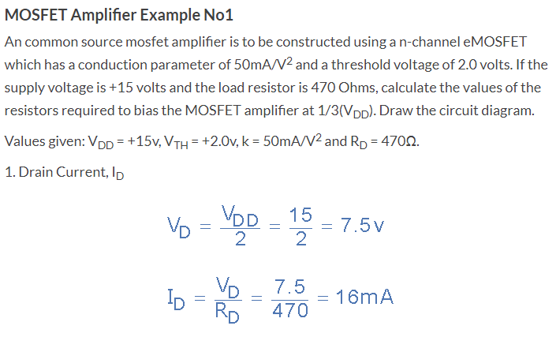

Slide 12
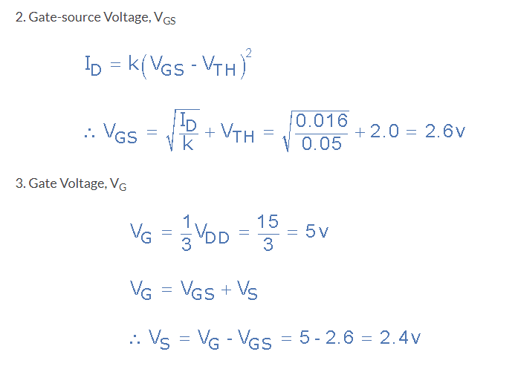

Slide 13
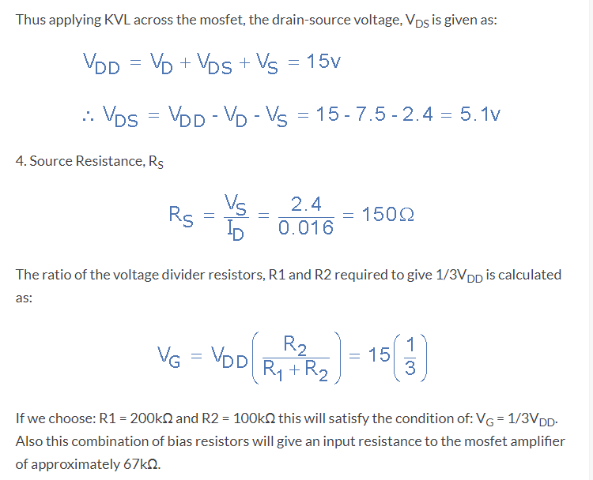

Slide 14
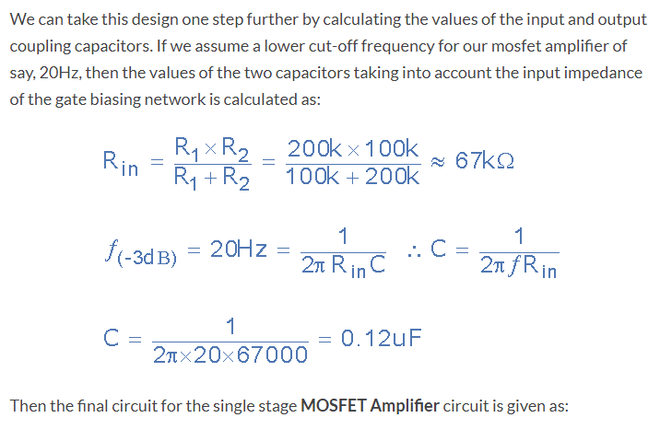

Slide 15
